Slide 1
Contest debriefing
Scientific Committee

Slide 2
Result
Total: 50 teams
First 4 hours only | A | B | C | D | E | F | G | H | I | J | K | L
Solved / Tries | 18/97 (19%) | 38/71 (54%) | 43/93 (46%) | 7/33 (21%) | 0/7 (0%) | 20/44 (45%) | 8/18 (44%) | 3/10 (30%) | 4/10 (40%) | 47/49 (96%) | 7/12 (58%) | 41/117 (35%)
Average tries | 3.73 | 1.69 | 1.98 | 2.75 | 1.75 | 1.76 | 2.00 | 1.43 | 1.67 | 1.04 | 1.50 | 2.34
Averages tries to solve | 3.22 | 1.63 | 1.98 | 3.14 | - | 1.75 | 2.12 | 1.67 | 1.75 | 1.04 | 1.57 | 1.78
Problem J: Free Food
Problem C: SG Coin
Problem L: Non-prime factors
Problem B: Hopper
Problem A: Largest Triangle
Problem D: Bitwise
Problem K: Conveyorbelts
Problem I: Prolonged Password
Problem E: Magical String
(For problems G, H, F, please read the solution by yourself ☺)
Ken
Felix
Suhendry

Slide 3
Free Food
Problem J
Author: Dr. Suhendry Effendy (NUS)
Tester: Dr. Felix Halim (Google), Dr. Steven Halim (NUS)

Slide 4
Problem
Input: N intervals (1 ≤ N ≤ 100)
Output: the number of days in which free food is served.
1 | 2 | 3 | 4 | 5 | 6 | 7 |  | 364 | 365
0 | 1 | 1 | 1 | 1 | 0 | 1 |  | 0 | 0

Slide 5
Solution
Note that
there are only 100 intervals and
each interval is of length at most 365.
We use brute-force solution.
Initialize the bit array B[1..365] as zeros
For each interval (s_{i}, t_{i}), mark B[s_{i}..t_{i}] = 1.
Report the number of bits B[i] equal 1
1 | 2 | 3 | 4 | 5 | 6 | 7 |  | 364 | 365
0 | 0 | 0 | 0 | 0 | 0 | 0 |  | 0 | 0

Slide 6
Solution
Note that
there are only 100 intervals and
each interval is of length at most 365.
We use brute-force solution.
Initialize the bit array B[1..365] as zeros
For each interval (s_{i}, t_{i}), mark B[s_{i}..t_{i}] = 1.
Report the number of bits B[i] equal 1
1 | 2 | 3 | 4 | 5 | 6 | 7 |  | 364 | 365
0 | 1 | 1 | 1 | 0 | 0 | 0 |  | 0 | 0

Slide 7
Solution
Note that
there are only 100 intervals and
each interval is of length at most 365.
We use brute-force solution.
Initialize the bit array B[1..365] as zeros
For each interval (s_{i}, t_{i}), mark B[s_{i}..t_{i}] = 1.
Report the number of bits B[i] equal 1
1 | 2 | 3 | 4 | 5 | 6 | 7 |  | 364 | 365
0 | 1 | 1 | 1 | 1 | 0 | 0 |  | 0 | 0

Slide 8
Solution
Note that
there are only 100 intervals and
each interval is of length at most 365.
We use brute-force solution.
Initialize the bit array B[1..365] as zeros
For each interval (s_{i}, t_{i}), mark B[s_{i}..t_{i}] = 1.
Report the number of bits B[i] equal 1
1 | 2 | 3 | 4 | 5 | 6 | 7 |  | 364 | 365
0 | 1 | 1 | 1 | 1 | 0 | 1 |  | 0 | 0

Slide 9
SG Coin
Problem C
Author: Dr. Felix Halim (Google)
Tester: Dr. Suhendry Effendy (NUS), Dr. Steven Halim (NUS)

Slide 10
Problem
Given a block Z with HashValue α_{Z} (with 9 digits and 7 trailing zeros), you need to generate two blocks A and B such that
α_{A}=H(α_{Z},S_{A},T_{A}) has 9 digits and 7 trailing zeros; and
α_{B}=H(α_{A},S_{B},T_{B}) has 9 digits and 7 trailing zeros.
prevHashValue: ??
Transaction: ??
Token: ??
HashValue: α_{Z}
prevHashValue: α_{Z}
Transaction: S_{A}
Token: T_{A}
HashValue: α_{A}=H(α_{Z},S_{A},T_{A})
prevHashValue: α_{A}
Transaction: S_{B}
Token: T_{B}
HashValue: α_{B}=H(α_{A},S_{B},T_{B})
Block Z
Block A
Block B

Slide 11
Simple solution
1. Randomly generate S_{A} and T_{A}.
2. Compute α_{A}=H(α_{Z},S_{A},T_{A})
3. Randomly generate S_{B} and T_{B}.
4. Compute α_{B}=H(α_{A},S_{B},T_{B})
5. Output S_{A}, T_{A}, S_{B}, T_{B}.
The running time is slow since you need to compute H().
prevHashValue: ??
Transaction: ??
Token: ??
HashValue: α_{Z}
prevHashValue: α_{Z}
Transaction: S_{A}
Token: T_{A}
HashValue: α_{A}=H(α_{Z},S_{A},T_{A})
prevHashValue: α_{A}
Transaction: S_{B}
Token: T_{B}
HashValue: α_{B}=H(α_{A},S_{B},T_{B})
Block Z
Block A
Block B

Slide 12
Speedup 1: Use a short
The running time of H() depends on the length of transaction. So, we use one character “X” for transaction.
1. Randomly generate T_{A}.
2. Compute α_{A}=H(α_{Z},“X”,T_{A})
3. Randomly generate T_{B}.
4. Compute α_{B}=H(α_{A},“X”,T_{B})
5. Output “X”, T_{A}, “X”, T_{B}.
prevHashValue: ??
Transaction: ??
Token: ??
HashValue: α_{Z}
prevHashValue: α_{Z}
Transaction: “X”
Token: T_{A}
HashValue: α_{A}=H(α_{Z}, “X”, T_{A})
prevHashValue: α_{A}
Transaction: “X”
Token: T_{B}
HashValue: α_{B}=H(α_{A}, “X”, T_{B})
Block Z
Block A
Block B

Slide 13
Observation
Since all HashValues have 9 digits and 7 trailing zeros, there are 99 different HashValues:
010000000
020000000
030000000
…
990000000

Slide 14
Build Lookup table
Token β
For each hashValue α, we find a token such that 990000000=H(α, “X”, β).
Since there are only 100 HashValues, we can precompute a table T[] where
T[α] equals the token β such that 990000000=H(α, “X”, β)
000000000
000000001
000000002
…
…
…
…
…
…
…
…
…
999999998
999999999
HashValue α
010000000
020000000
030000000
…
…
…
…
…
…
980000000
990000000
T[α]=β such that 000000000=H(α, “X”, β)

Slide 15
Solution
If the hashValue of block Z is α_{Z}, the output is
“X”, T[α_{Z}]
“X”, T[990000000]
By table lookup, O(1) time.
prevHashValue: ??
Transaction: ??
Token: ??
HashValue: α_{Z}
prevHashValue: α_{Z}
Transaction: “X”
Token: T[α_{Z}]
HashValue: 990000000=H(α_{Z}, “X”, T[α_{Z}])
prevHashValue: 990000000
Transaction: “X”
Token: T[990000000]
HashValue: 990000000=H(α_{A}, “X”, T[990000000])
Block Z
Block A
Block B

Slide 16
Remark
Accidentally, this problem is very similar to the problem H in Yangon 2018 (on last Sunday, 9 Dec).
Note that we submit the problem last month.
This is just a coincidence.

Slide 17
Non-Prime Factors
Problem L
Author: Dr. Steven Halim (NUS)
Tester: Dr. Felix Halim (Google), Dr. Suhendry Effendy (NUS)

Slide 18
Problem
Input: an integer i
Output: NPF(i), which is the number of non-prime factors of i.
Example: i = 40.
40 has 8 factors:
1, 2, 4, 5, 8, 10, 20, 40.
40 has 2 prime factors: 2, 5.
40 has 6 non-prime factors:
1, 4, 8, 10, 20, 40.
NPF(40)=6.

Slide 19
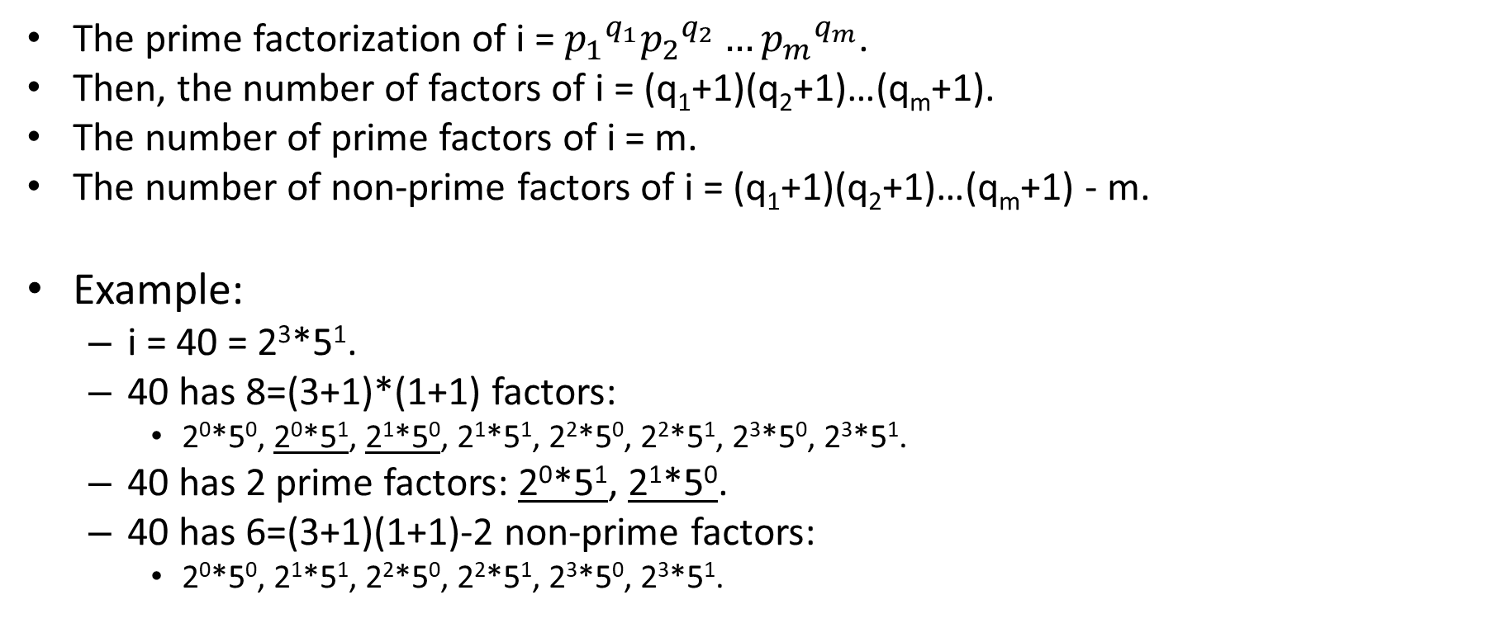
Theorem
The prime factorization of i = ${p_{1}}^{q_{1}}{p_{2}}^{q_{2}}…{p_{m}}^{q_{m}}$.
Then, the number of factors of i = (q₁+1)(q₂+1)…(q_{m}+1).
The number of prime factors of i = m.
The number of non-prime factors of i = (q₁+1)(q₂+1)…(q_{m}+1) - m.
Example:
i = 40 = 2³*5¹.
40 has 8=(3+1)*(1+1) factors:
2⁰*5⁰, 2⁰*5¹, 2¹*5⁰, 2¹*5¹, 2²*5⁰, 2²*5¹, 2³*5⁰, 2³*5¹.
40 has 2 prime factors: 2⁰*5¹, 2¹*5⁰.
40 has 6=(3+1)(1+1)-2 non-prime factors:
2⁰*5⁰, 2¹*5¹, 2²*5⁰, 2²*5¹, 2³*5⁰, 2³*5¹.

Slide 20
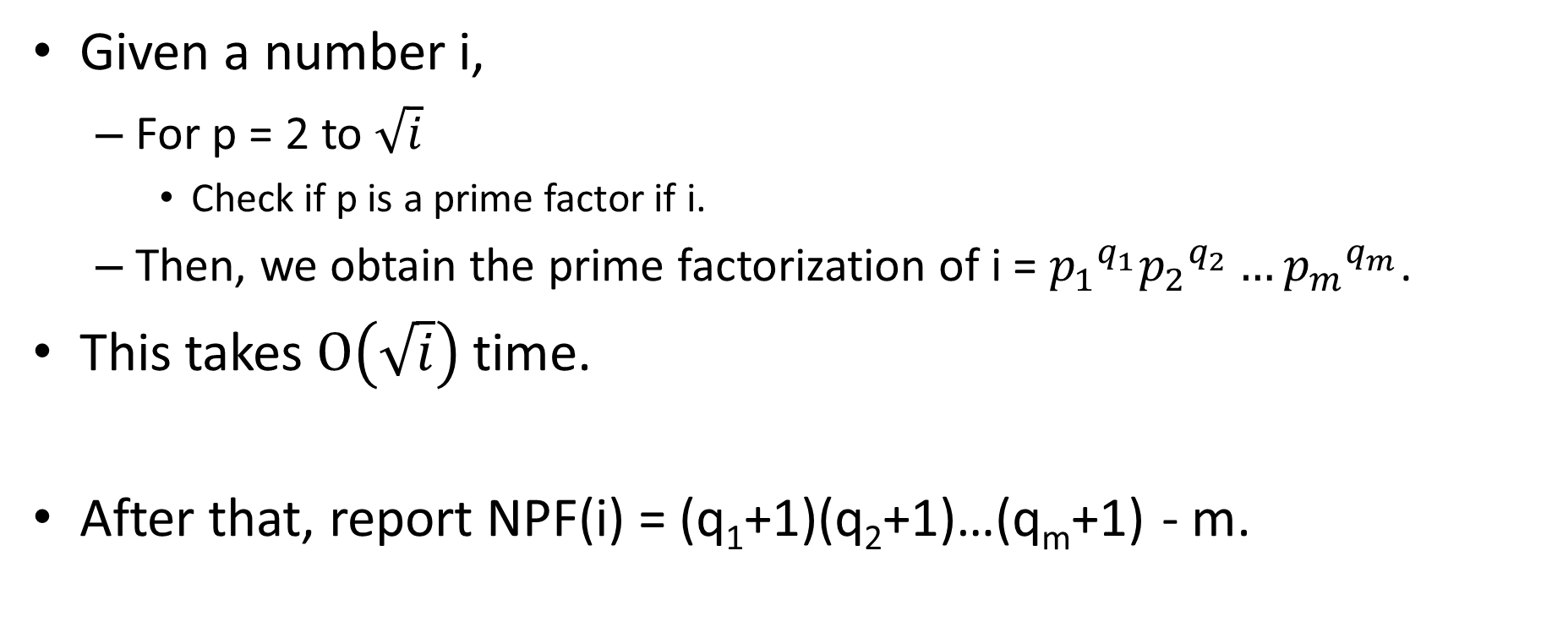
Solution
Given a number i,
For p = 2 to $\sqrt{i}$
Check if p is a prime factor if i.
Then, we obtain the prime factorization of i = ${p_{1}}^{q_{1}}{p_{2}}^{q_{2}}…{p_{m}}^{q_{m}}$.
This takes $O\left(\sqrt{i}\right)$ time.
After that, report NPF(i) = (q₁+1)(q₂+1)…(q_{m}+1) - m.

Slide 21
Another solution
Given a number i,
Find all non-prime factors of i using a modified sieve of eratosthenes algorithm
Basically, run sieve of eratosthenes algorithm but cross out all the prime number
Then, we count the number of non-prime numbers
Notes:
Eric top sinly

Slide 22
Further speedup
It is still not fast enough!
Speedup 1: File I/O is slow.
C language: Instead of using cin/count, use scanf/printf.
Java language: Instead of using Scanner/System.out.println, use BufferedReader/PrintWriter.

Slide 23
Further speedup
Speedup 2: Observe that
There are at most 3*10⁶ queries.
The maximum value of i is 2*10⁶.
By pigeon-hole principle, some queries NPF(i) are duplicates.
To save computational time, you can store the answers in a hash table.

Slide 24
Remark
Since this question requires a lot of I/O, python will die miserably.

Slide 25
Hoppers
Problem B
Author: Hubert Teo Hua Kian (Stanford University)
Tester: Dr. Suhendry Effendy (NUS), Dr. Steven Halim (NUS)

Slide 26
Problem
Input: An undirected network with N nodes and M edges
Malware ‘hopper’: If a node is infected, its neighbors’ neighbors will be infected.
A network is unsafe if one node v is infected by ‘hopper’, all nodes in the network will be infected.
Output: The minimum of number of additional edges to make the network unsafe.
Example 1: Add zero edge to make G unsafe.
If we infect node 1,
Node 2 will be infected since 1-5-4-3-2 is of even length.
Node 3 will be infected since 1-2-3 is of even length.
Node 4 will be infected since 1-5-4 is of even length.
Node 5 will be infected since 1-2-3-4-5 is of even length.
1
1
2
2
3
3
5
5
4
4

Slide 27
Problem
Example 2: The original graph G is safe.
If we infect node 1,
Node 3 will be infected since 1-2-3 is of even length.
Cannot further propagate.
If we infect node 2,
Node 4 will be infected since 2-3-4 is of even length.
Cannot further propagate.
After we add 1 edge (1, 3), G is unsafe.
If we infect node 1,
Node 2 will be infected since 1-3-2 is of even length.
Node 3 will be infected since 1-2-3 is of even length.
Node 4 will be infected since 1-3-2 is of even length.
1
2
4
3

Slide 28
Idea
6
6
Lemma: If G does not have odd cycle, then G is safe.
Proof: If G does not have odd cycle, then G is 2-colorable, say red and blue.
If you infect a red node, all red nodes will be infected but not blue nodes.
If you infect a blue node, all blue nodes will be infected but not red nodes.
So, G is safe.
1
1
2
2
5
5
4
4
3
3
10
10
7
7
9
9
8
8

Slide 29
Idea
Lemma: Consider an odd cycle 1 – 2 – 3 – … – n. For any node j,
Either 1-2-3-…-j or 1-n-(n-1)-…-j is of even length.
Proof:
For odd j,
1-2-3-…-j is of even length.
For even j,
1-n-(n-1)-…-j is of even length.
1
1
n
n
2
2
n-1
n-1
3
3
4
4
5
5

Slide 30
Idea
Lemma: Suppose the graph G is connected and has an odd cycle. G is unsafe.
After we infect a node v in the odd cycle, all nodes will be infected.
Proof: Let 1-2-…-n be the odd cycle in G.
For any node u in G,
either 1-2-…-j-…-u or 1-n-(n-1)-…-j-…-u is of even length.
Hence, there is an even-length path from 1 to u.
All nodes are infected.
G is unsafe.
1
1
n
2
n-1
3
4
j
5
u

Slide 31
Theorem
Lemma: Suppose the graph G has k connected component.
Case 1: If G has an odd cycle, we need to add k-1 edges.
Case 2: If G does not have an odd cycle, we need to add k edges.
Proof for case 1:
We add k-1 edges to link all k components.
If we infect u, u has an length-even path to all nodes in G.
All nodes will be infected.
u

Slide 32
Theorem
Lemma: Suppose the network G has k connected component.
Case 1: If G has an odd cycle, we need to add k-1 edges.
Case 2: If G does not have an odd cycle, we need to add k edges.
Proof for case 2:
We add k-1 edges to link all k components.
There is no odd cycle.
So, the network is still unsafe.
We add a link (v, w).
u-v-w is a triangle, odd-length cycle.
All nodes will be infected.
u
v
w

Slide 33
Solution
1. Let k be the number of connected components
2. By DFS (or BFS), detect if there is an odd cycle.
3. If there is an odd cycle,
Report k-1
Otherwise, report k.
This algorithm runs in O(N+M) time.

Slide 34
Largest Triangle
Problem A
Author: Dr. Steven Halim (NUS)
Tester: Dr. Felix Halim (Google), Dr. Suhendry Effendy (NUS)

Slide 35
Problem
Input: A set of points.
Output: The area of the largest triangle.

Slide 36
Naïve solution
Enumerate all 3 points.
Find the one with the biggest area.
This solution takes O(N³) time.
It rendered Time-Limit-Exceeded (TLE)

Slide 37
A better solution
We can reduce the number of points by filter out:
Duplicate points
Points not in convex hull
Points that are collinear
However, it is still not fast enough.
x
x
x
x
x
x
x
x
x

Slide 38
Idea of the solution
A triangle is said rooted at a if one of its endpoint is a.
Let the convex hull be P = p₀, p₁, …, p_{n}.
Area = 0
For i = 0 to n
Set A_{i} = area of the largest triangle rooted at p_{i}.
If (A_{i} > Area) then Area = A_{i}
Report Area
Below, we show that “area of the largest triangle rooted at p_{i}” can be computed in O(n) time.
So, we give an O(n²) time algorithm.
p₅
p₄
p₆
p₇
p₃
p₈
p₂
p₁
p₀

Slide 39
Find the largest triangle rooted at a
Area of the largest triangle rooted at ‘a’ can be found using an idea similar to the rotating caliper algorithm

Slide 40
Find the largest triangle rooted at a
Let the convex hull be p₀, p₁, …, p_{N}.
Set a=p₀, b=p₁, c=p₂
Area = Δabc
While (c ≠ p_{N})
c’=next(c)
While (Δabc’ ≥ Δabc)
If (Δabc’ > Area) then Area = Δabc’
c = c’
b = next(b)
Return Area
This algorithm runs in O(N) time.
p₃
p₄
p₂
p₅
p₁
p₀
Keikha et al. Maximum-Area Triangle in a Convex Polygon, Revisited. 2017.

Slide 41
Find the largest triangle rooted at a
Let the convex hull be p₀, p₁, …, p_{N}.
Set a=p₀, b=p₁, c=p₂
Area = Δabc
While (c ≠ p_{N})
c’=next(c)
While (Δabc’ ≥ Δabc)
If (Δabc’ > Area) then Area = Δabc’
c = c’
b = next(b)
Return Area
This algorithm runs in O(N) time.
←
c’
p₃
←
c
p₄
p₂
←
←
p₅
b
p₁
p₀
a
Area = Δp₀p₁p₃
Area = Δp₀p₁p₂

Slide 42
Find the largest triangle rooted at a
Let the convex hull be p₀, p₁, …, p_{N}.
Set a=p₀, b=p₁, c=p₂
Area = Δabc
While (c ≠ p_{N})
c’=next(c)
While (Δabc’ ≥ Δabc)
If (Δabc’ > Area) then Area = Δabc’
c = c’
b = next(b)
Return Area
This algorithm runs in O(N) time.
c
p₃
p₄
p₂
←
p₅
b
p₁
p₀
a
Area = Δp₀p₁p₃

Slide 43
Find the largest triangle rooted at a
Let the convex hull be p₀, p₁, …, p_{N}.
Set a=p₀, b=p₁, c=p₂
Area = Δabc
While (c ≠ p_{N})
c’=next(c)
While (Δabc’ ≥ Δabc)
If (Δabc’ > Area) then Area = Δabc’
c = c’
b = next(b)
Return Area
This algorithm runs in O(N) time.
c
p₃
c’
b
p₄
p₂
←
←
←
p₅
p₁
p₀
a
Area = Δp₀p₁p₃
Area = Δp₀p₂p₄

Slide 44
Find the largest triangle rooted at a
Let the convex hull be p₀, p₁, …, p_{N}.
Set a=p₀, b=p₁, c=p₂
Area = Δabc
While (c ≠ p_{N})
c’=next(c)
While (Δabc’ ≥ Δabc)
If (Δabc’ > Area) then Area = Δabc’
c = c’
b = next(b)
Return Area
This algorithm runs in O(N) time.
p₃
c
b
p₄
p₂
←
p₅
p₁
p₀
a
Area = Δp₀p₂p₄

Slide 45
Find the largest triangle rooted at a
Let the convex hull be p₀, p₁, …, p_{N}.
Set a=p₀, b=p₁, c=p₂
Area = Δabc
While (c ≠ p_{N})
c’=next(c)
While (Δabc’ ≥ Δabc)
If (Δabc’ > Area) then Area = Δabc’
c = c’
b = next(b)
Return Area
This algorithm runs in O(N) time.
p₃
c
b
p₄
p₂
←
←
p₅
c’
p₁
p₀
a
Area = Δp₀p₂p₄

Slide 46
Find the largest triangle rooted at a
Let the convex hull be p₀, p₁, …, p_{N}.
Set a=p₀, b=p₁, c=p₂
Area = Δabc
While (c ≠ p_{N})
c’=next(c)
While (Δabc’ ≥ Δabc)
If (Δabc’ > Area) then Area = Δabc’
c = c’
b = next(b)
Return Area
This algorithm runs in O(N) time.
p₃
c
b
p₄
p₂
←
←
p₅
c’
p₁
p₀
a
Area = Δp₀p₂p₄

Slide 47
Find the largest triangle rooted at a
Let the convex hull be p₀, p₁, …, p_{N}.
Set a=p₀, b=p₁, c=p₂
Area = Δabc
While (c ≠ p_{N})
c’=next(c)
While (Δabc’ ≥ Δabc)
If (Δabc’ > Area) then Area = Δabc’
c = c’
b = next(b)
Return Area
This algorithm runs in O(N) time.
p₃
b
p₄
p₂
←
p₅
c
p₁
p₀
a
Area = Δp₀p₂p₄

Slide 48
Find the largest triangle rooted at a
Let the convex hull be p₀, p₁, …, p_{N}.
Set a=p₀, b=p₁, c=p₂
Area = Δabc
While (c ≠p_{N})
c’=next(c)
While (Δabc’ ≥ Δabc)
If (Δabc’ > Area) then Area = Δabc’
c = c’
b = next(b)
Return Area
This algorithm runs in O(N) time.
p₃
p₄
p₂
←
p₅
b
c
←
p₁
p₀
a
Area = Δp₀p₂p₄

Slide 49
Even faster solution
O(n²) solution can pass all test cases.
This problem actually can be solved in O(n log n) time.
Keikha et al. Maximum-Area Triangle in a Convex Polygon, Revisited. 2017.
https://arxiv.org/pdf/1705.11035.pdf
The above paper also showed that idea based on the “modified rotating caliper algorithm” cannot give an O(n) time.

Slide 50
Remark
1. This is the only geometry problem in the set, added to diversify the problem types.
2. For large test cases in this problem, it requires to generate many points in a convex hull.
We actually use the solution in ICPC.SG.2015 to generate the large test cases.
https://open.kattis.com/problems/convex

Slide 51
Acknowledgement (related to Scientific committee)
Problem setters
Sean Pek Yu Xuan (NUS, SGP, prelim tasks only),
Shafaet Ashraf (Traveloka, SGP),
Dr Felix Halim (Google, USA; ICPC World Finalist 2007),
Raymond Kang Seng Ing (Google, USA; 2x ICPC World Finalist 2015, 2018),
Hubert Teo Hua Kian (Stanford University, USA; 2x ICPC World Finalist 2016, 2018),
Chin Zhan Xiong (Nuro, USA; 2x ICPC World Finalist 2017, 2018),
Nguyen Tan Sy Nguyen (Anduin Transactions, VNM; 2x ICPC World Finalist 2013, 2016),
Kyle See (Augmented Intelligence Pros, Philippines, World Finalist 2016),
Irvan Jahja (NUS, SGP, 2x ICPC World Finalist 2012, 2013),
Dr Suhendry Effendy (NUS, SGP, ICPC Asia Jakarta Head Judge 2010-2016),
Dr Steven Halim (NUS, SGP, 6x ICPC World Finalist (Coach 3x/RCD 2x/Attendee 1x) 2010, 2012, 2014, 2015, 2016, 2018).
Tester
Dr Suhendry Effendy (NUS, SGP, ICPC Asia Jakarta Head Judge 2010-2016),
Dr Felix Halim (Google, USA; ICPC World Finalist 2007),
Dr Steven Halim (NUS, SGP, 6x ICPC World Finalist (Coach) 2010, 2012, 2014-16, 2018),
Shen Chuanqi (Google, USA; ICPC World Finalist 2015),
Nguyen Thanh Trung (Google, SGP; ICPC World Finalist 2012, 2016).
Honorary Judges from Kattis team
Dr Fredrik Niemelä,
Associate Professor Greg Hamerly.

Slide 52
2-stable triangle rooted at a
Let the convex hull be P = p₀, p₁, …, p_{n}. Fixed a=p₀.
A triangle is said rooted at a if one of its endpoint is a.
A triangle Δabc rooted at a is said to be 2-stable if
Δab’c, Δabc’ ≤ Δabc for all b’ and c’.
Lemma: Suppose Δabc and Δab’c’ are 2-stable. We have:
b ≤ b’ ≤ c ≤ c’ or b’ ≤ b ≤ c ≤ c’in P
b
b’
c
c’
a
Keikha et al. Maximum-Area Triangle in a Convex Polygon, Revisited. 2017.

